Slide 1

Chilled Surfaces:
Ceilings, Floors, and Beams
ASHRAE Chapter,
Meeting
Stanley A. Mumma, Ph.D., P.E.
Prof. Emeritus, Architectural Engineering
PSU, Univ. Park, PA
sam11@psu.edu
Web: http://doas-radiant.psu.edu

Slide 2
Key Learning Objectives
Chilled surface description and operating fundamentals
Current HVAC system of choice review
Conceptual integration of chilled surface systems into an HVAC system
A few of the 14 WIIFMe(s) of chilled surface systems
Applications
Perceived Cons of chilled surface systems
Conclusions

Slide 3
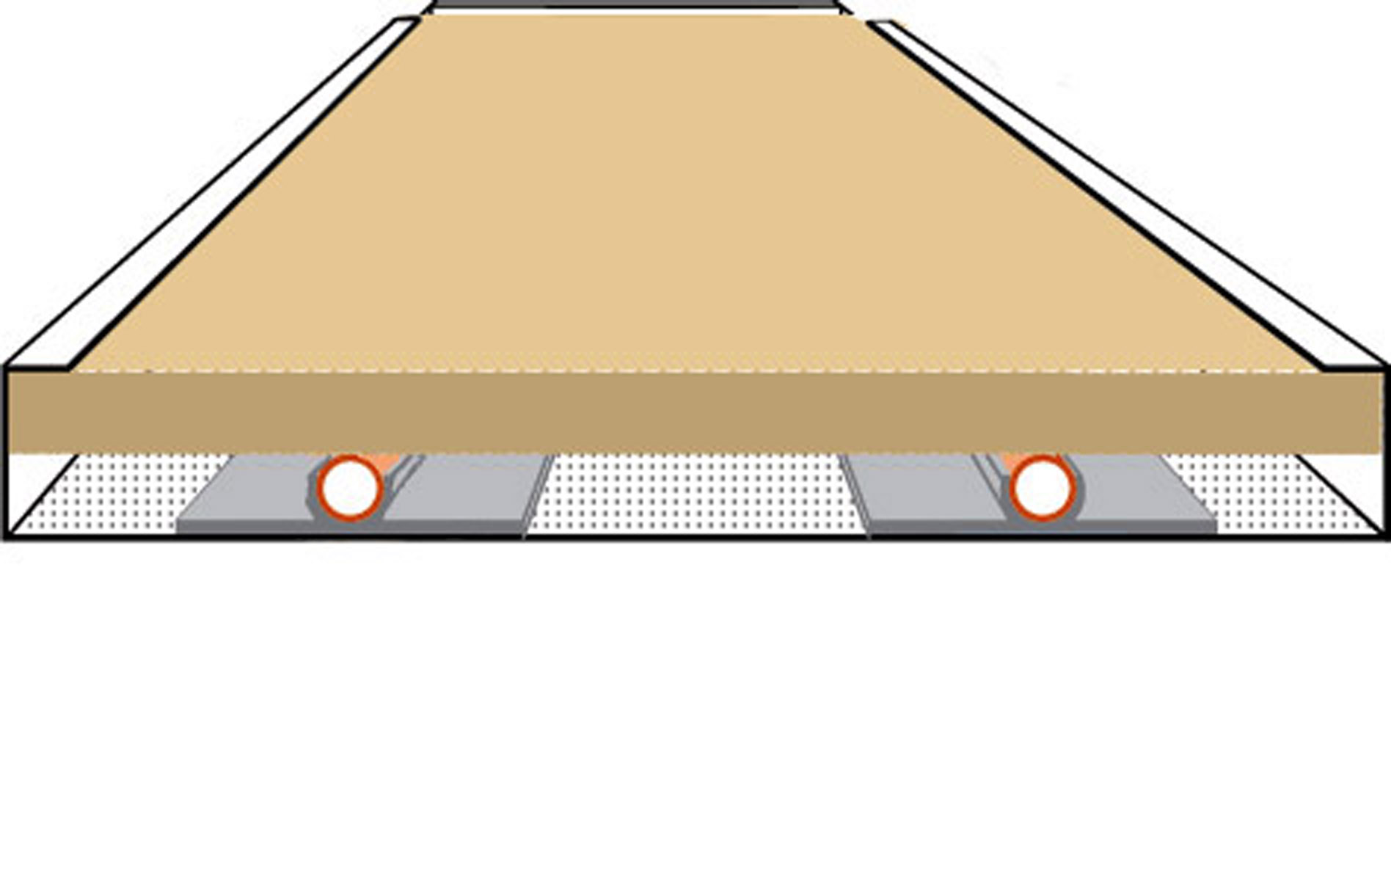
Ceiling Radiant Panel

Slide 4
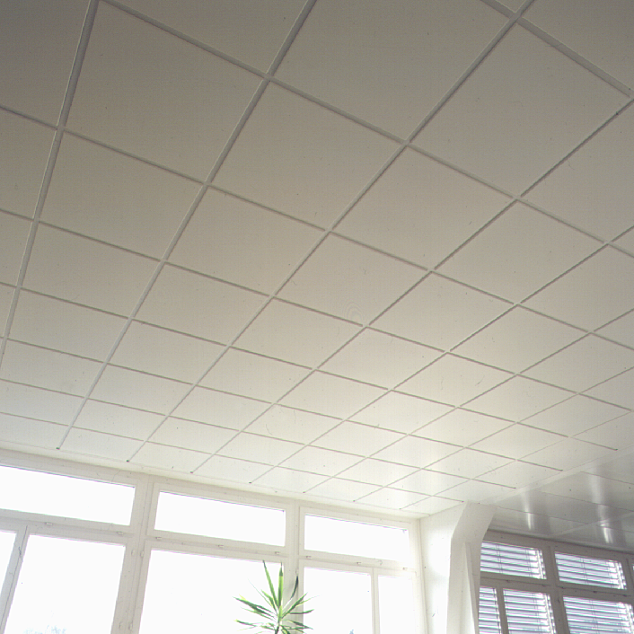
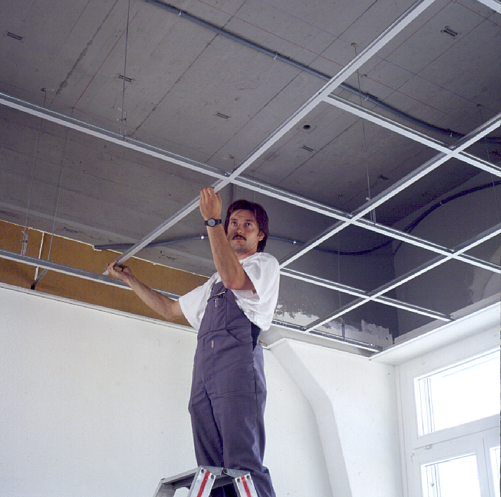
Ceiling Radiant Panel

Slide 5
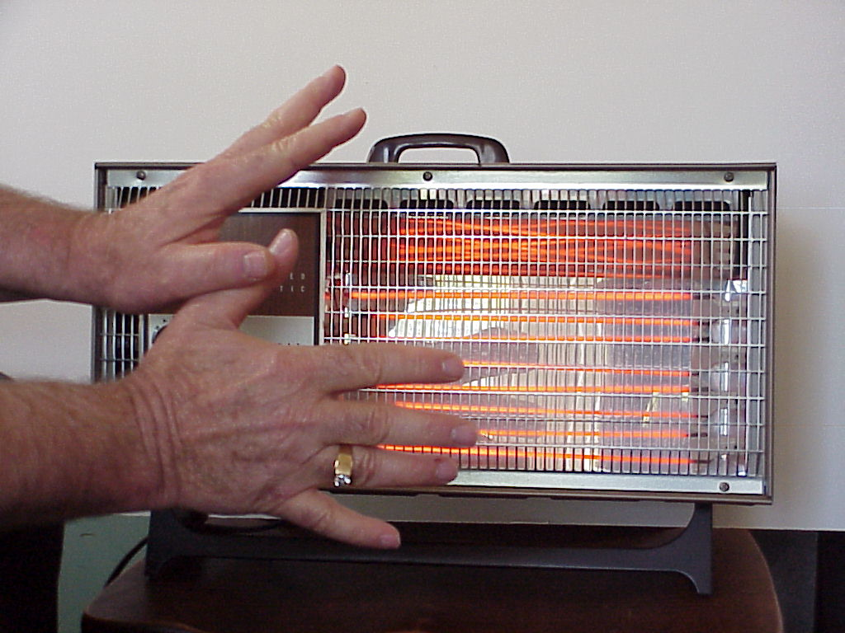
Radiant Heating

Slide 6
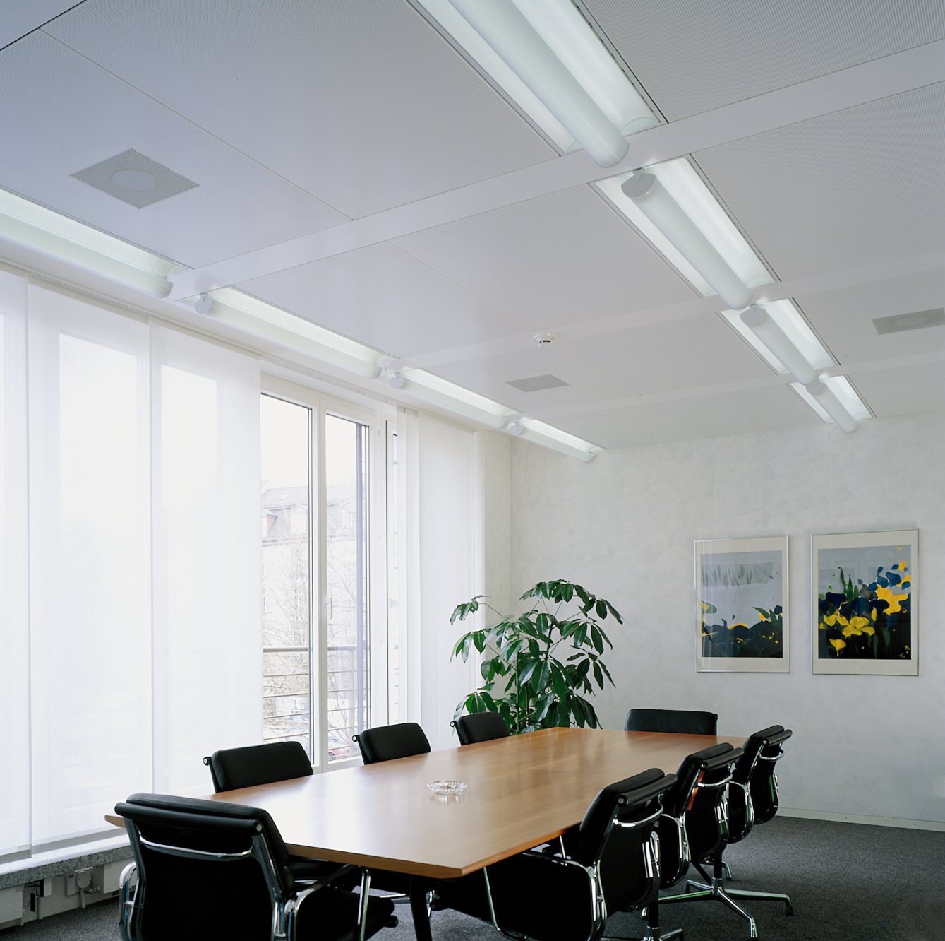
Radiant Cooling
Ceiling ~60F
Total Sensible
34 Btu/hr-ft²
Radiation
20 Btu/hr-ft²
Convection
14 Btu/hr-ft²

Slide 7
Active Chilled Beam
No: It is the old
induction box system
applied by W H Carrier.
I Beam
@ 45F?

Slide 8
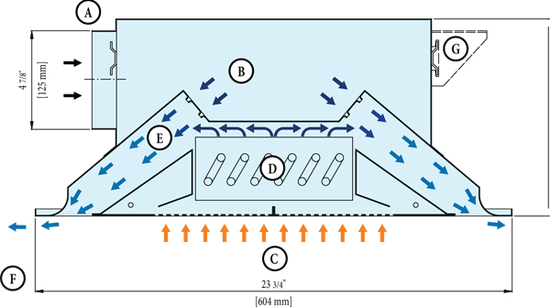
Manufacturer A

Slide 9
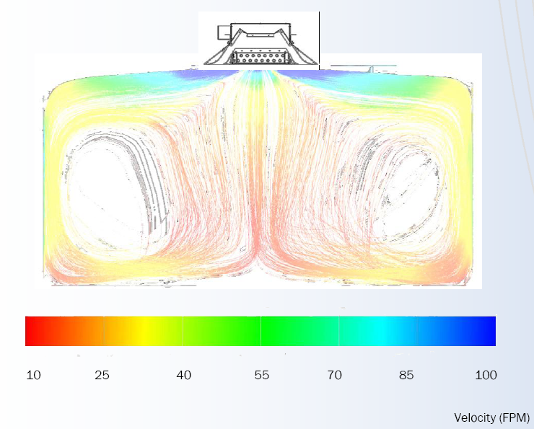
Manufacturer B

Slide 10
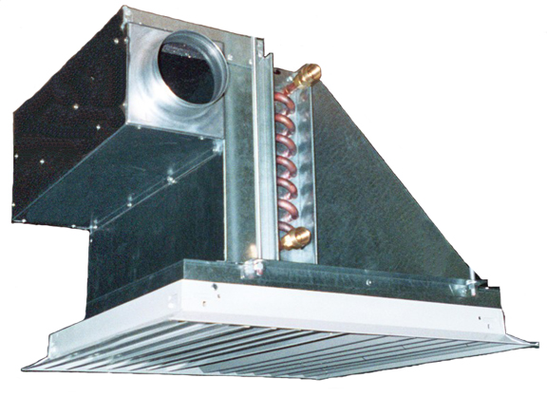
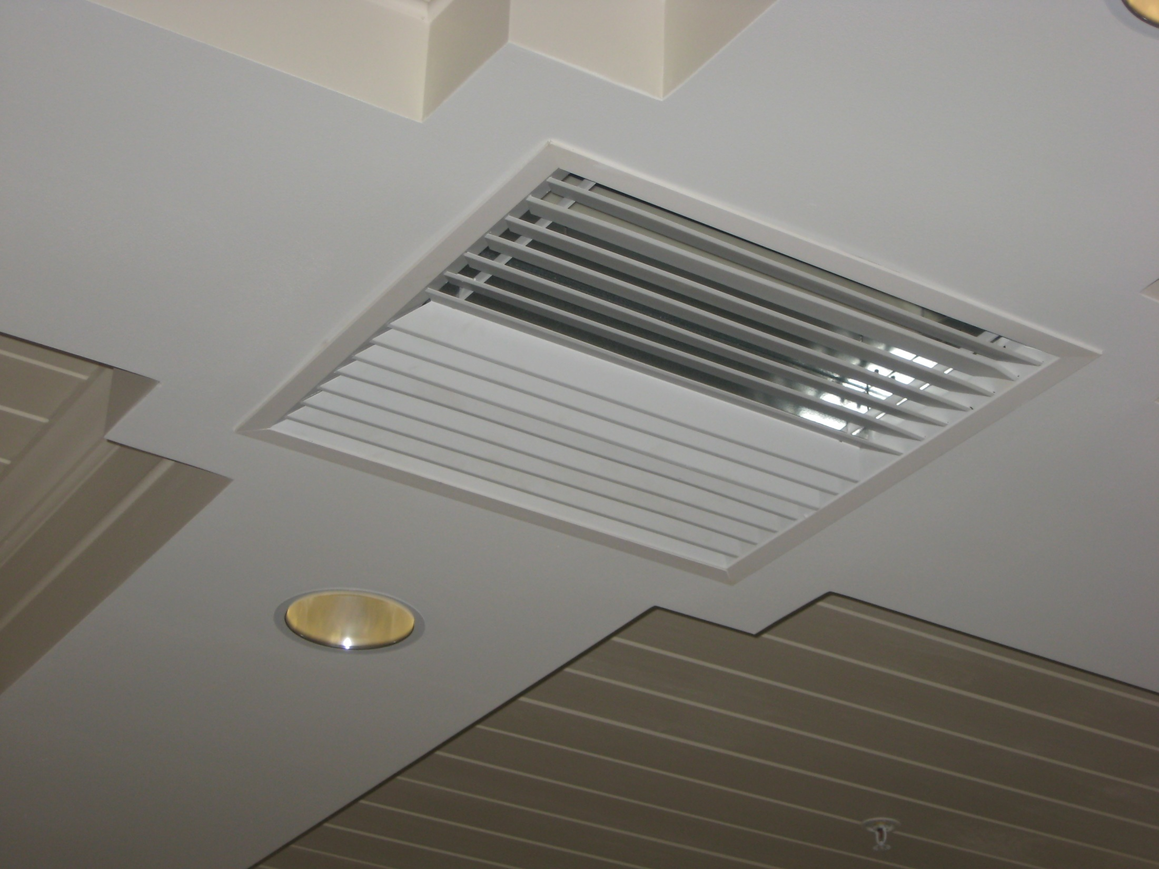
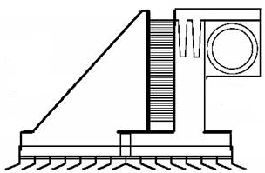
EXHAUST AIR TO DOAS
Manufacturer C

Slide 11
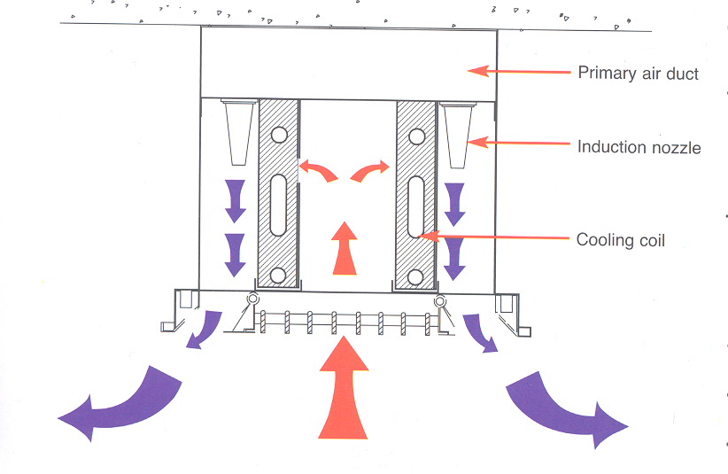
Beam Coil HT/ft
300-600 Btu/hr
Vs.
Ceiling panel HT/ft, 70 Btu/hr
DOAS air
Induction Nozzle
Sen Cooling Coil
Room air
Manufacturer D

Slide 12
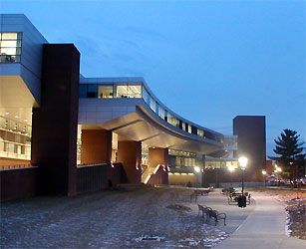

Slide 13
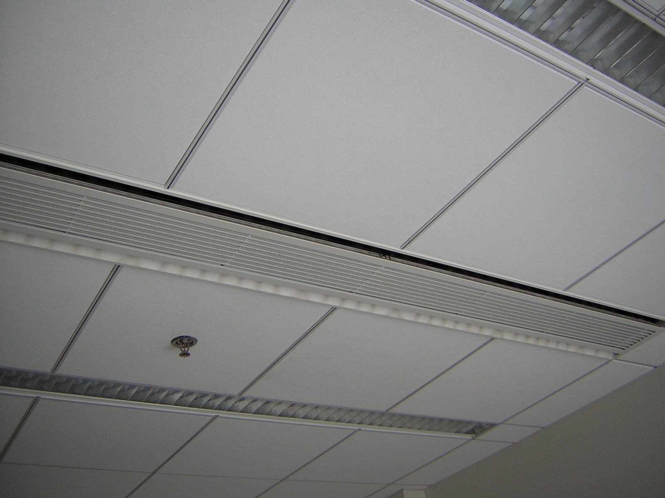
DOAS air
Induction Nozzle
Sen Cooling Coil
Room air

Slide 14
Passive Chilled Beam

Slide 15
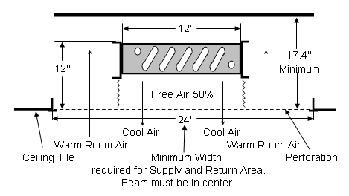
Q_{Total}= up to 128-268 Btu/hr-linear ft cooling
Fluid in, 62-52F
Fluid out,66-56F
75F, 40%
32-46 fpm draft 3 ft below ceiling

Slide 16
Chilled Floor
Best for atria areas or other with high solar loads on the floor.

Slide 17

Chilled Floor

Slide 18
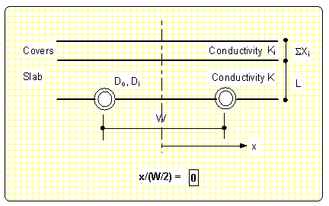
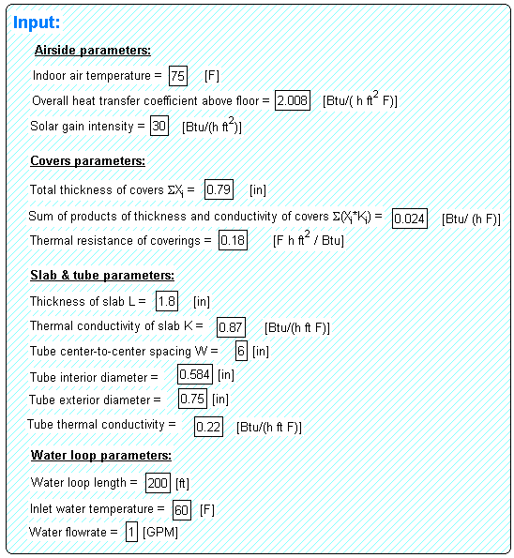
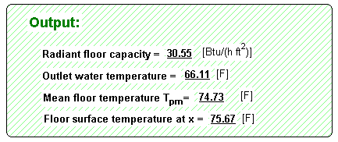

Slide 19
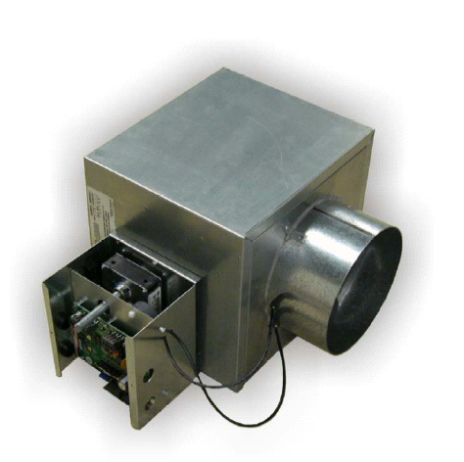
Variable Air Volume (VAV)
Current HVAC system of choice
Many unsolved
inherant problems
OA,
AHU
Return Air
1
2
3
4
Relief Air
Sensible Cooling, ~20 Btu/hr-ft²

Slide 20
Inherent problems with VAV Systems
Poor air distribution.
Poor humidity control.
Poor acoustical properties.
Poor use of plenum and mechanical shaft space.
Serious control problems, particularly with tracking return fan systems.
Poor energy transport medium, air.
Poor resistance to the threat of biological and chemical terrorism, and
Poor and unpredictable ventilation performance.

Slide 21
Chilled surface/Ventilation Air (DOAS) Arrangement
20-70% less OA
than VAV
High Induction Diffuser
Cool/Dry Supply
DOAS Unit W/ Energy Recovery
Building With Sensible and Latent cooling decoupled
Parallel Sen. Cooling System
Chilled surfaces
Pressurization

Slide 22

WIIFMe: #1,
K.I.S.S. But no simpler
Radiant is much
simpler than VAV

Slide 23

WIIFMe: #2,
First Cost Reduced?
Possible if system
designed properly!

Slide 24
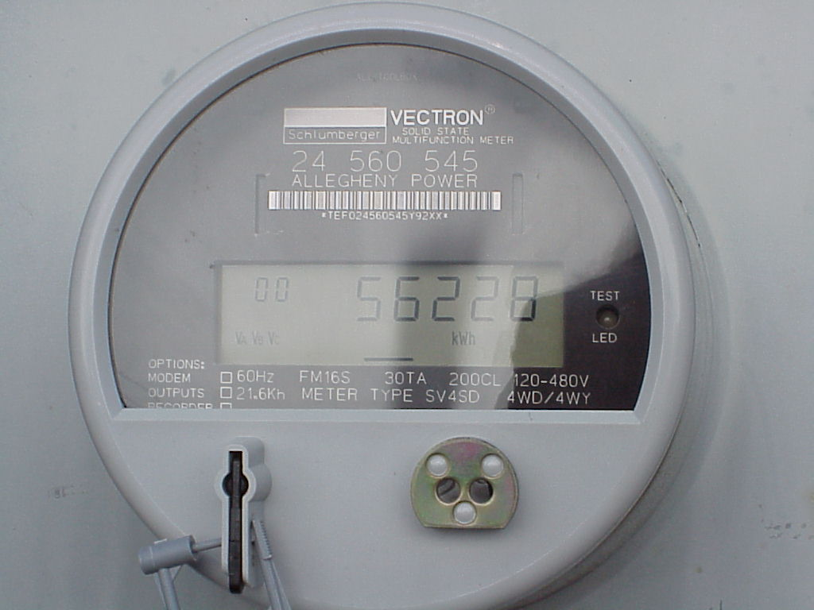
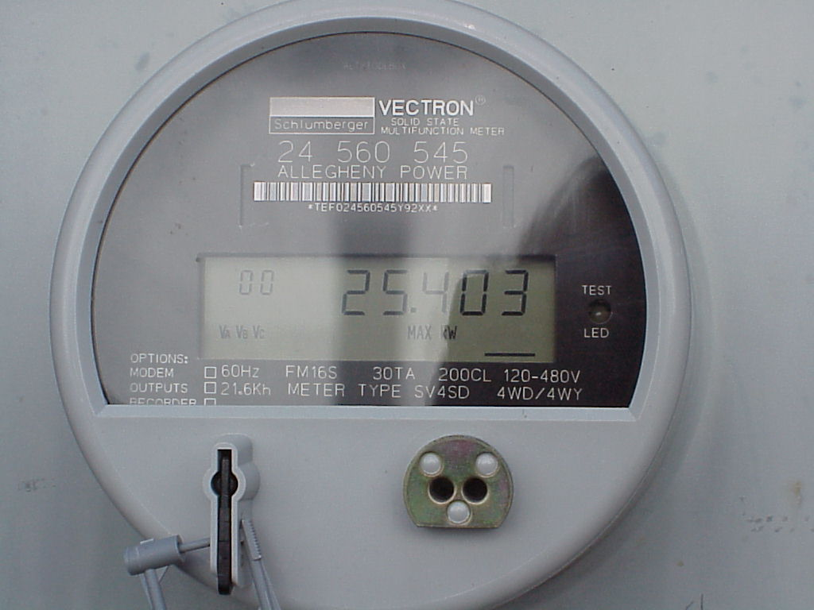
WIIFMe: #3,
Energy demand (kW),
& use (kWh) reduced
58% the kWh
use of VAV
50% the kW
demand of VAV

Slide 25
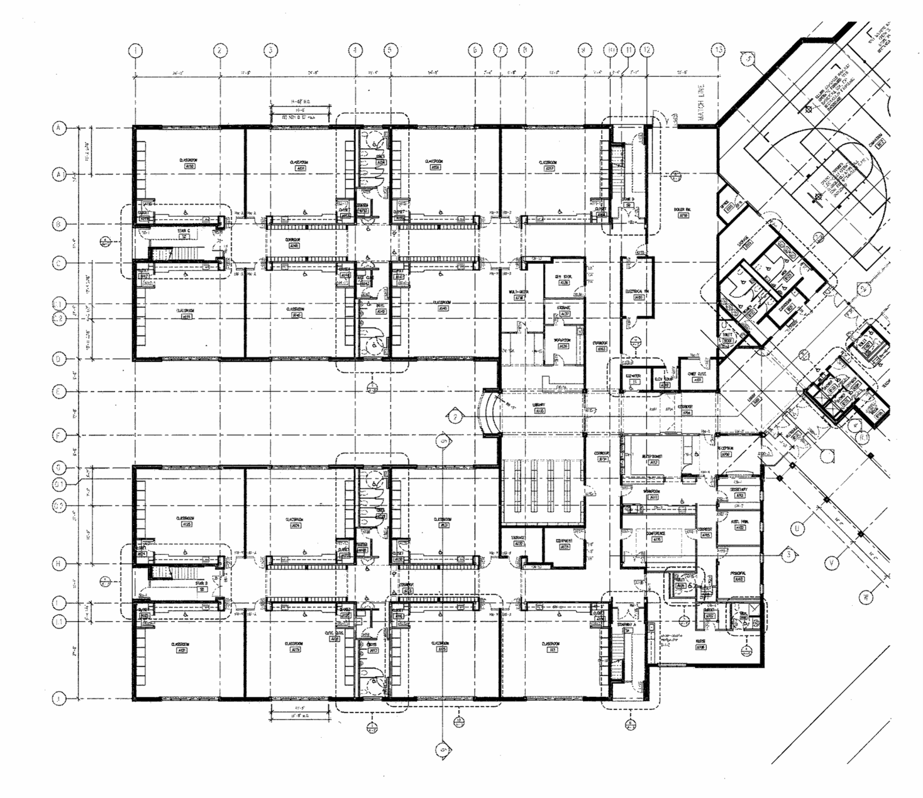
WIIFMe: #5, 75% Smaller Mech. Rooms & Shafts

Slide 26
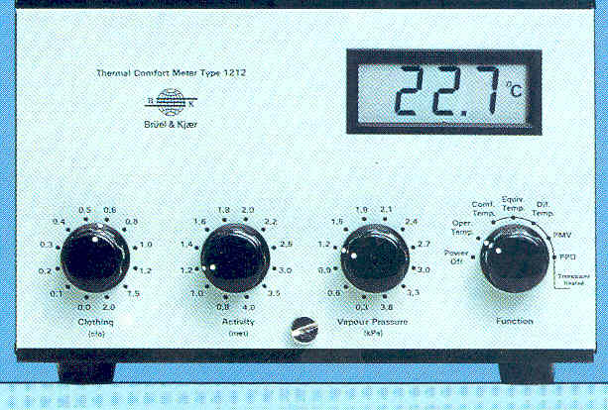
WIIFMe: #8, Enhanced
Env. Quality
Thermal Comfort
Velocity,
MRT, DBT,
RH, met, clo

Slide 27
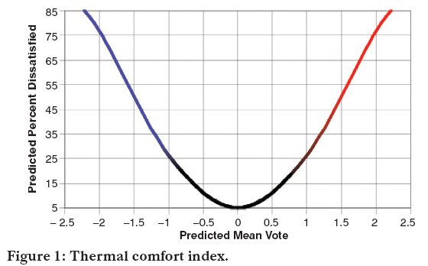
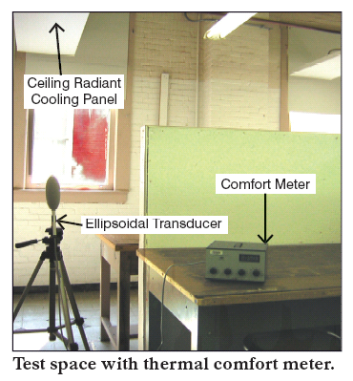
WIIFMe: #8, Enhanced
Env. Quality
Thermal Comfort Testing
PMV: -0.01 to +0.07
PPD: 5.1 to 5.4%
ASHRAE Std. PPD: 20%

Slide 28
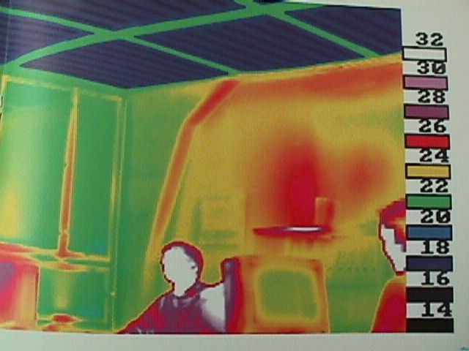
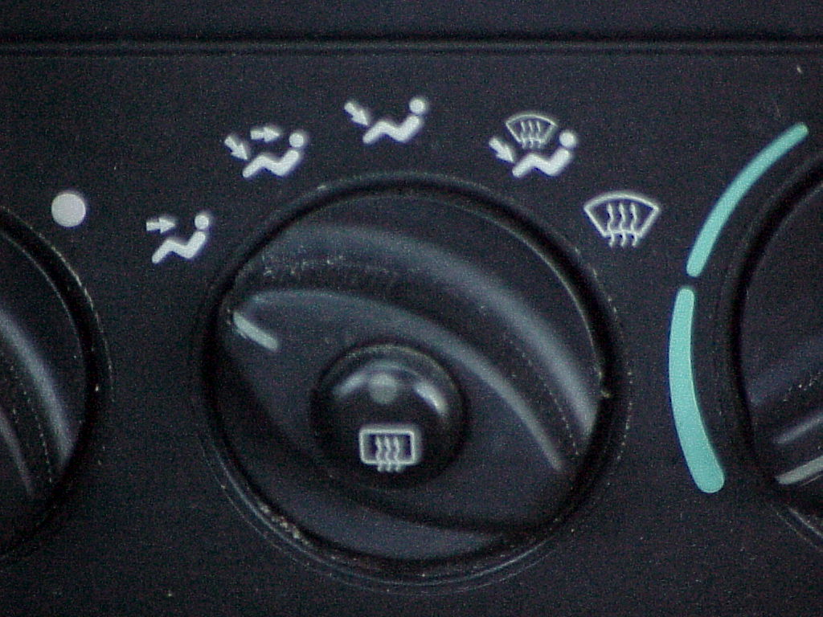
WIIFMe: #8, Enhanced
Env. Quality
Proper heat balance on body

Slide 29
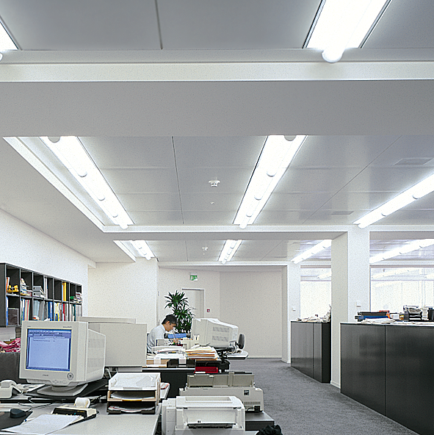
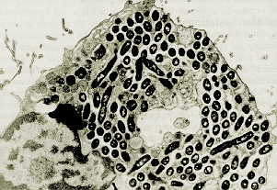
WIIFMe: #9, Enhanced
IAQ, Productivity, &
Safety
No recirculation: i.e.. 100% OA

Slide 30
WIIFMe: #11,
Reduced Plenum Depth
Duct
Suspended Ceiling

Slide 31
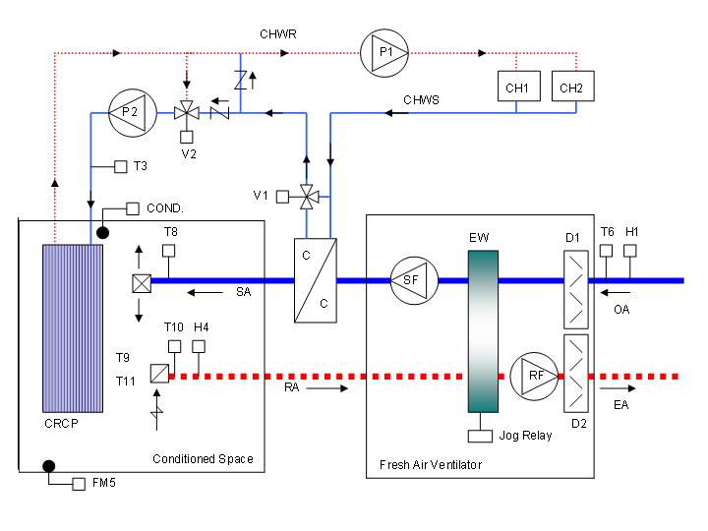
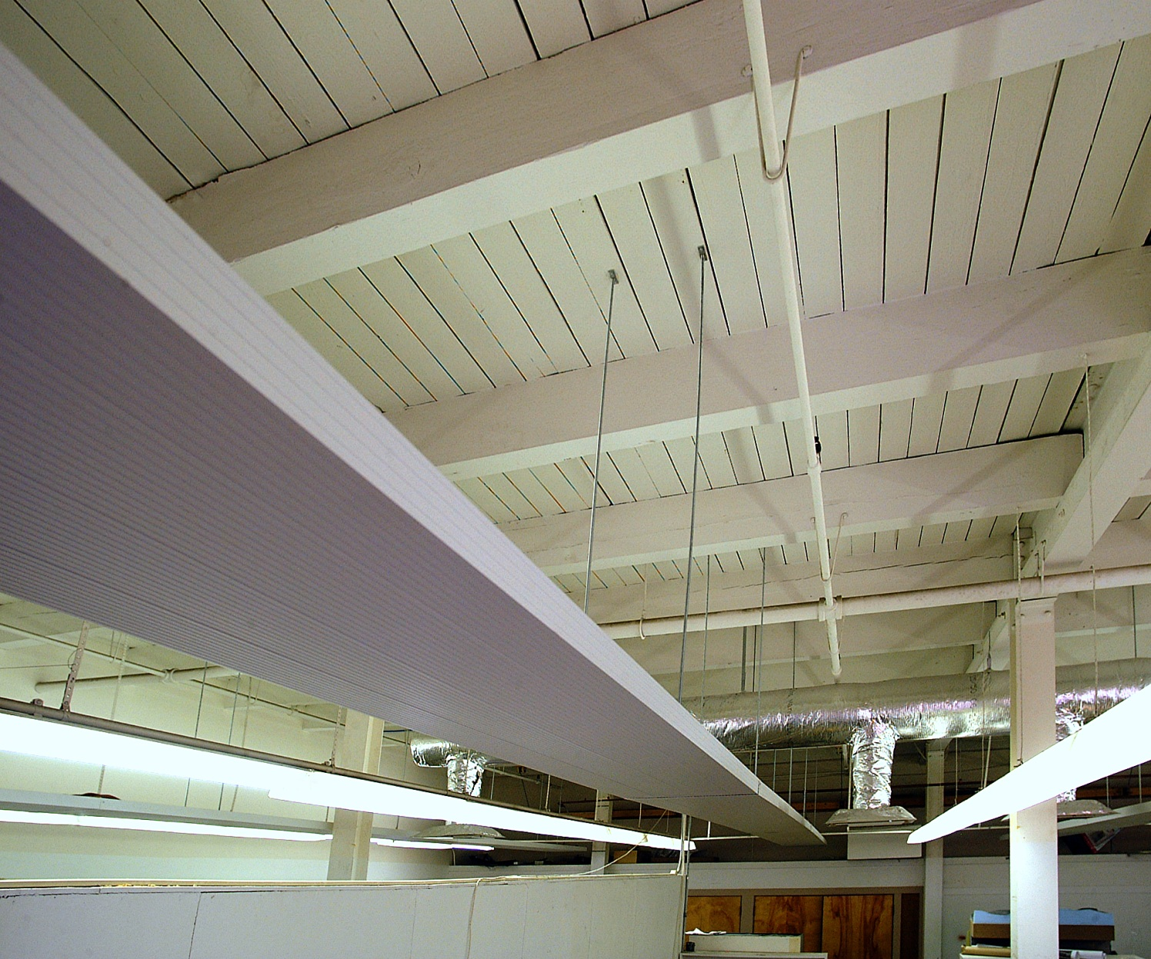
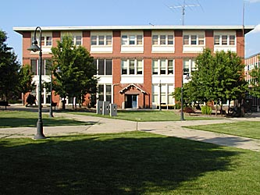
WIIFMe: #12, A proven technology in the US
Pennsylvania Classroom

Slide 32
Using radiant panels to temper cold OA

Slide 33
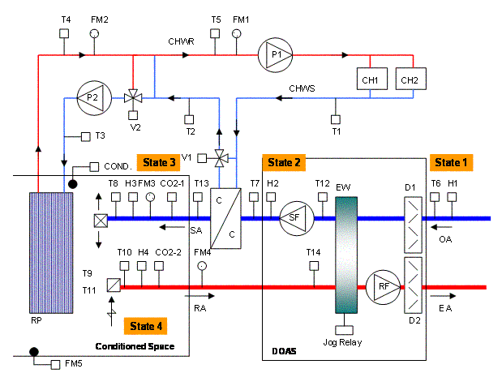
Tempering OA without the loss of air side economizer!
DOAS Unit
Parallel sen. unit

Slide 34
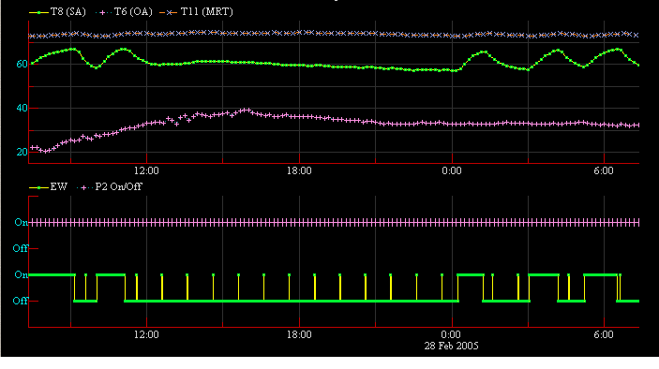
Free cooling performance data
Space T (MRT)
SA DBT
OA DBT
Panel Pump (P2) On
EW on/off
Midnight

Slide 35
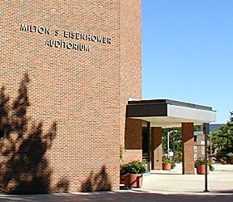
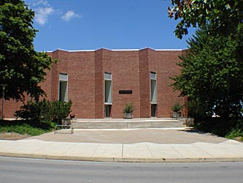
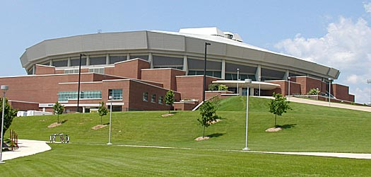
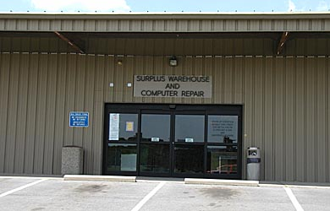
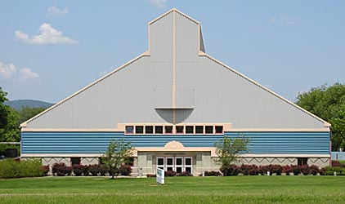
WIIFMe: #13, Applicable in many buildings, but not all
Excellent for:
commercial,
institutional,
educational,
medical.

Slide 36

WIIFMe: #14, Applicable in virtually all climates

Slide 37

Sooo.......... If it is so
great, When will the
LIGHTNING STRIKE?

Slide 38
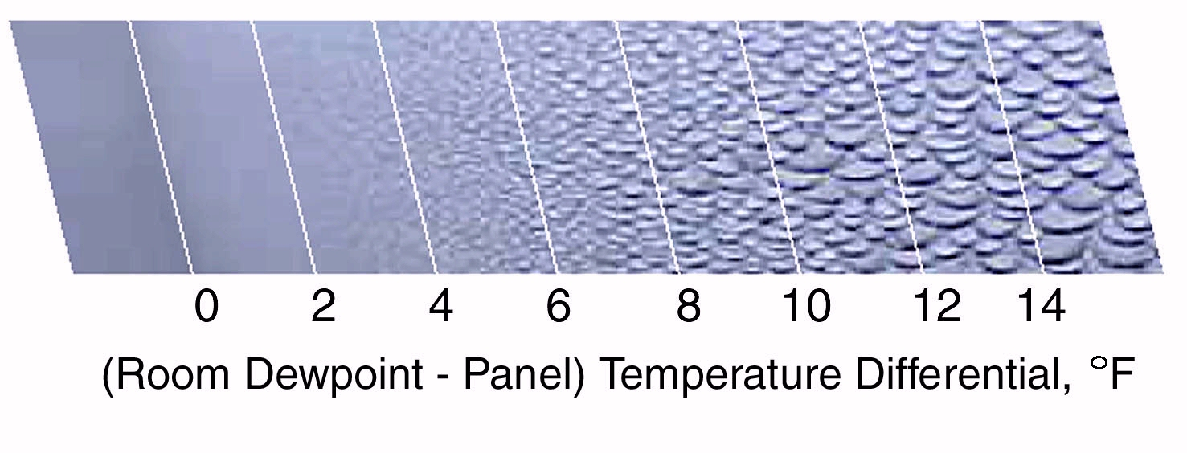
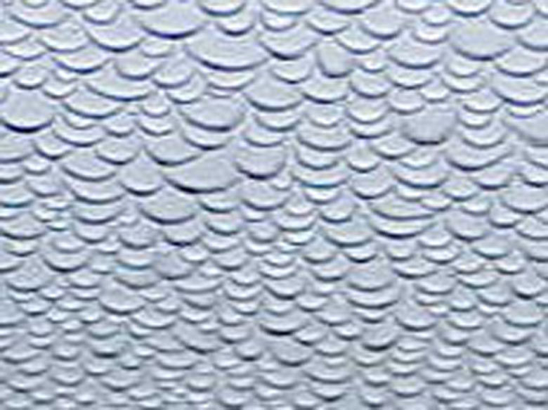
Need never
occur! How?
Perceived Con #1,
Condensation

Slide 39
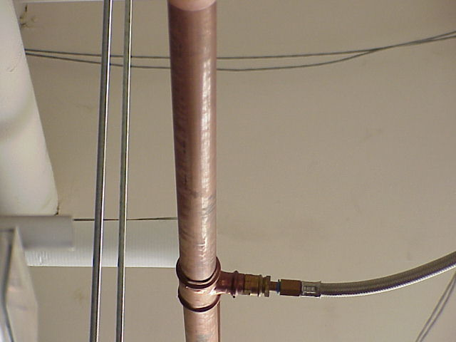
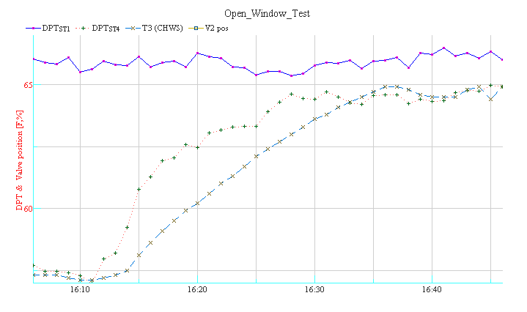
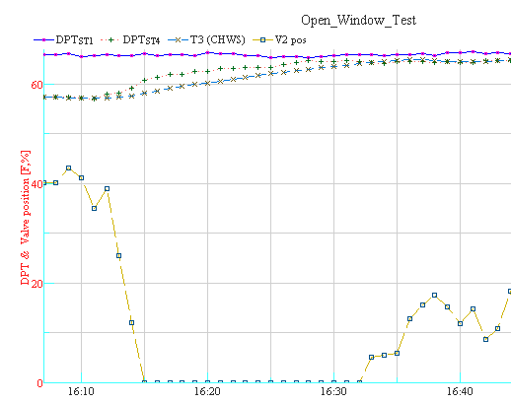
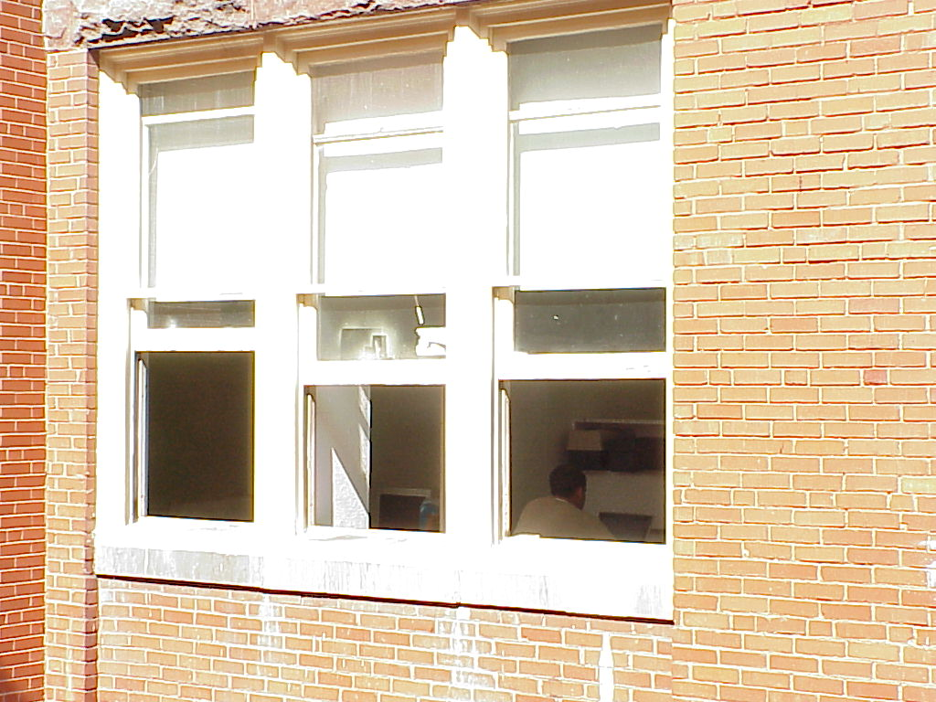
Condensation test,
Open all doors and windows

Slide 40
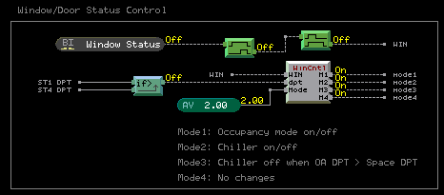
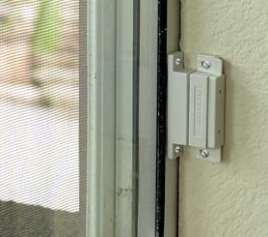
Back up condensate control

Slide 41
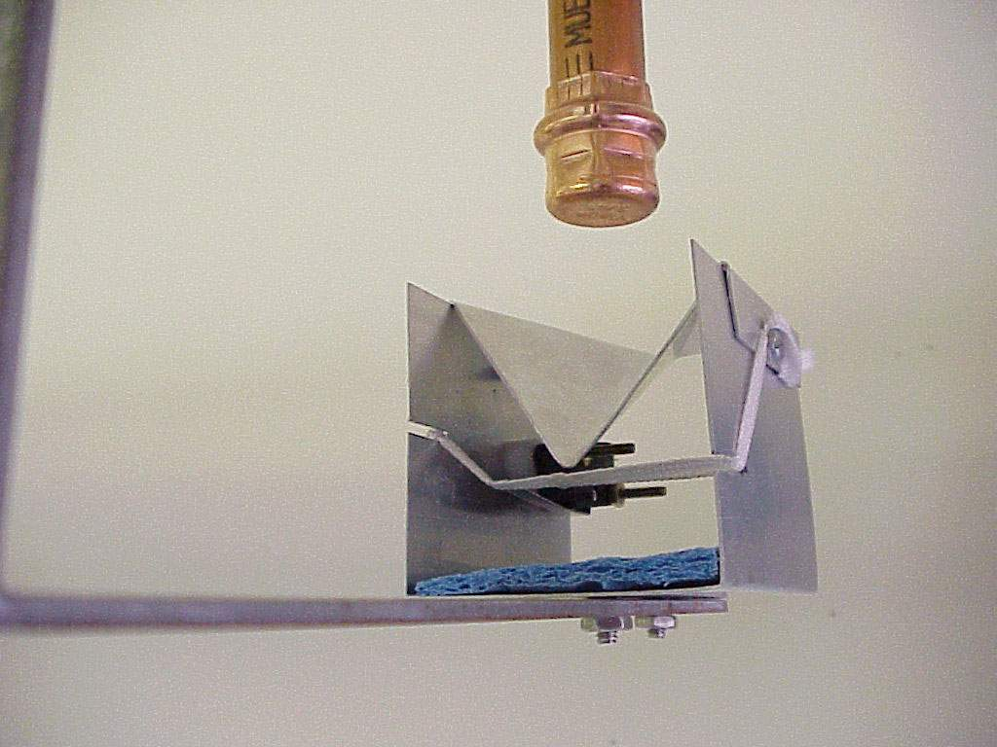
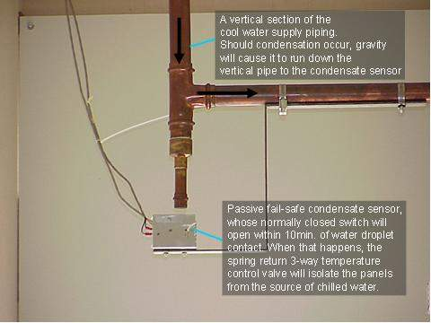
Back up condensate control

Slide 42
Perceived Con #2,
Capacity
* 300 ft²/ton rule of thumb = 40 Btu/hr-ft²
* Radiant panel can remove about 35 Btu/hr-ft², sen
* Many conclude must cover the ceiling and part
of the walls to provide the capacity.
* But VAV can only provide up to 20 Btu/hr-ft², sen
* DOAS provides up to 6.5 Btu/hr-ft², sen
* Panel capacity req’d, 20-6.5=13.5 Btu/hr-ft², sen
* TRUTH: no capacity problem, and only
need about 50% of the ceiling for spaces typical
of office density. High density spaces will need
less than 50%.

Slide 43
Perceived Con #3, High 1st Cost
Case Study summary follows:

Slide 44
6 story 186,000 ft² Office Building
Analysis uses VAV as a reference!
Chiller and pumps 1st cost reduced by 40%
Ductwork cost reduced by 75%
AHU’s reduced by 80%
Building Electrical service reduced
Building height per floor reduced
Lost rentable space devoted to mech. rooms and shafts recovered.
Savings: $1,405,000
Radiant panel add: $1,030,000
Net savings: $375,000 or $2/ft²

Slide 45
For more information, see DOAS web page:
System related
  Chilled Ceilings in Parallel with Dedicated Outdoor Air Systems: Addressing the Concerns of Condensation, Capacity, and Cost
  http://doas-radiant.psu.edu/DOAS_RADIANT_HONOLULU_TP4573.pdf
Thermal Comfort
  Comfort With DOAS Radiant Cooling System http://doas-radiant.psu.edu/IAQ_comfort_04.pdf
Condensate control
  Chilled Ceiling Condensation Control
  http://doas-radiant.psu.edu/cond_control_fall_03.pdf
  Backup Condensation Control Via Portal Sensors http://doas-radiant.psu.edu/IAQ_winter_05.pdf

Slide 46
For more information, see DOAS web page:
Fundamentals
  Ceiling Radiant Cooling Panels Employing Heat-Conducting Rails: Deriving the Governing Heat Transfer Equations
  http://doas-radiant.psu.edu/Xia_Mumma_CRCP_HCR_06.pdf
Design steps
  Designing a Dedicated Outdoor Air System with Ceiling Radiant Cooling Panels
  http://doas-radiant.psu.edu/Design_DOAS_CRCP_fall_06_Journal.pdf

Slide 47
For more information, see DOAS web page:
Controls
  Direct Digital Temperature, Humidity, and Condensate Control for a Dedicated Outdoor Air-Ceiling Radiant Cooling Panel System
  http://doas-radiant.psu.edu/OR-05-3-3.pdf
Terror resistance
  DOAS and homeland security
  http://doas-radiant.psu.edu/ES_Jan_2007_DOAS_HS.pdf

Slide 48
Conclusions
Chilled surface Technology Introduced.
A few WIIFMe Items Discussed
3 Perceived Cons dismissed
Chilled surface/DOAS Mech. Systems generate many LEED rating points
Natural environment and resources preserved; plus human health, Safety & productivity enhanced with
Chilled Surface/DOAS !!
Helps assure a future for Our Children and Grand Children
I invite you to join with all of us who are implementing these exciting green technologies for the future!

Slide 49
Questions

