Slide 1
Dedicated Outdoor Air Systems (DOAS) Automatic Control Considerations
ASHRAE 2012 Winter conference, Chicago
Seminar 50, #1: January 25, 2012
Stanley A. Mumma, Ph.D., P.E.
Prof. Emeritus, Architectural Engineering
Penn State University, Univ. Park, PA
sam11@psu.edu
Web: http://doas-radiant.psu.edu

Slide 2
Learning Objectives for this Session
DOAS heat recovery control related to dehumidification & free cooling.
Building pressurization.
Freeze protection.
Limiting terminal reheat—including demand controlled ventilation.
ASHRAE is a Registered Provider with The American Institute of Architects Continuing Education Systems. Credit earned on completion of this program will be reported to ASHRAE Records for AIA members. Certificates of Completion for non-AIA members are available on request.
This program is registered with the AIA/ASHRAE for continuing professional education. As such, it does not include content that may be deemed or construed to be an approval or endorsement by the AIA of any material of construction or any method or manner of handling, using, distributing, or dealing in any material or product. Questions related to specific materials, methods, and services will be addressed at the conclusion of this presentation.

Slide 3
DOAS Defined for This Presentation
20%-70% less OA,
than VAV
High Induction Diffuser
Cool/Dry Supply
DOAS Unit w/ Energy Recovery
Building with Sensible and Latent Cooling Decoupled
Parallel Sensible Cooling System
Pressurization

Slide 4
DOAS Equipment arrangements on the Market Today
H/C coil, w/ or w/o sensible energy recovery (SER, i.e hot gas, wheel, plate, heat pipe) for reheat.
H/C coil w/ TER (EW, plate).
H/C coil w/ TER and passive dehumidification wheel.
H/C coil w/ TER and active dehumidification wheel.

Slide 5
DOAS Equipment on the Market Today
K.I.S.S. (b): H/C coils with TER
Pressurization
TER
Fan
RA
5
4
Space
1
2
3
OA
FCU
PH
CC
SA DBT, DPT to decouple space loads?

Slide 6
EW
RA
5
1
2
3
4
Space
2
OA
PH
CC
Hot & humid OA condition
3
5
4

Slide 7
Key DOAS Points
100% OA delivered to each zone via its own ductwork
Flow rate generally as spec. by Std. 62.1 or greater (LEED, Latent. Ctl)
Employ TER, per Std. 90.1
Generally CV
Use to decouple space S/L loads—Dry
Rarely supply at a neutral temperature
Use HID, particularly where parallel system does not use air

Slide 8
Selecting the SA DBT & DPT for (b) arrangement: H/C coils with TER
Occ. Category | cfm/p | SA DPT ⁰F
Conf. rm | 6.2 | 24.84
Lec. cl | 8.42 | 35.9
Elem. cl | 11.71 | 42.75
Office | 17 | 47.18
Museum | 9 | 31.05

Slide 9
DOAS & Energy Recovery
ASHRAE Standard 90.1 and ASHRAE’s new Standard for the Design Of High Performance Green Buildings (189.1) both require most DOAS systems to utilize exhaust air (EA) energy recovery equipment with GT 50% or 60% energy recovery effectiveness:
  that means a change in the enthalpy of the outdoor air supply at least 50% or 60% of the difference between the outdoor air and return air enthalpies at design conditions.
Std 62.1 allows its use with class 1-3 air.

Slide 10
Note: DOAS by definition is 100% OA, i.e. >80% OA
Climate Zone 60% TER Req’d Std. 189.1-2009 Design Air flow when >80% OA
1A, 2A, 3A, 4A, 5A, 6A, 7, 8 (Moist E. US + Alaska) > 0 cfm (all sizes require TER)
6B > 1,500 cfm
1B, 2B, 5C > 4,000 cfm
3B, 3C, 4B, 4C, 5B > 5,000 cfm

Slide 11
~80% US population “A”
Climate Zone 60% TER Req’d Std. 189.1-2009 Design Air flow when >80% OA
1A, 2A, 3A, 4A, 5A, 6A, 7, 8 (Moist E. US + Alaska) > 0 cfm (all sizes require TER)
6B > 1,500 cfm
1B, 2B, 5C > 4,000 cfm
3B, 3C, 4B, 4C, 5B > 5,000 cfm

Slide 12
Climate Zone 60% TER Req’d Std. 189.1-2009 Design Air flow when >80% OA
1A, 2A, 3A, 4A, 5A, 6A, 7, 8 (Moist E. US + Alaska) > 0 cfm (all sizes require TER)
6B > 1,500 cfm
1B, 2B, 5C > 4,000 cfm
3B, 3C, 4B, 4C, 5B > 5,000 cfm

Slide 13
DOAS & Energy Recovery
Can the 50% and 60% enthalpy based EA energy recovery be achieved with a sensible heat recovery device?
Consider Boston with an ASHRAE 0.4% design dehumidification condition of 81.1 F MCDB and 122.9 gr/lbm humidity ratio.
The process is illustrated on the Psychrometric chart as follows:

Slide 14
Δh_{TER}
Design OA state point
Q_{TER} = 24 Btu/hr per scfm
with 50% effective TER
State point after
50% effective TER
Space state point

Slide 15
Q_{SER} = 7 Btu/hr per scfm
with 100% effective SER
Δh_{SER}
Design OA state point
State point after
100% effective SER
Space state point

Slide 16
DOAS & Energy Recovery
At the Boston Design dehumidification condition, 50% effective TER reduces the coil load by 24 Btu/hr per scfm.
For the same conditions, even a 100% eff. SER unit reduces the coil load by just
7 Btu/hr per scfm. Few SER devices have
an eff. >70%
For the SER approach to provide the heat transfer of a 50% eff. TER device, it would need an eff. of at least 24/7*100=340%. SER can not be used to meet Std 90.1 in Boston.

Slide 17
DOAS & Energy Recovery
For geographic locations in Moist US Zone A (where ~80% of US population reside), the Std. 90.1 total heat recovery criteria can not be met with SER units.

Slide 18
DOAS & Energy Recovery
For geographic locations in Moist US Zone A, the Std. 90.1 total heat recovery criteria can not be met with SER units.
The following major US cities can meet the Std. 90.1 criteria with SER only:
  Portland, OR
  Anchorage
  Butte
  Seattle
  Denver
  Albuquerque
  Boise
  Salt Lake City
  Los Angeles

Slide 19
DOAS & Energy Recovery
For geographic locations in Moist US Zone A, the Std. 90.1 total heat recovery criteria can not be met with SER units.
The following major US cities can meet the Std. 90.1 criteria with SER only:
  Portland, OR
  Anchorage
  Butte
  Seattle
  Denver
  Albuquerque
  Boise
  Salt Lake City
  Los Angeles
  i.e. locations with low design MCDB & low W’s.

Slide 20
Discussion for this presentation limited to 4 local loop control areas
Control to maximize the EW performance—including free cooling.
EW frost control to minimize energy use.
Control to minimize the use of terminal reheat.
Pressurization control.

Slide 21
Controls to maximize the EW performance—including free cooling.

Slide 22
TER control approaches
Run the EW continuously (no control).
Operate the EW based upon OA and RA enthalpy (enthalpy based control)
Operate the EW based upon OA and RA DBT (DBT based control)
NOTE:
  Cleaning cycle required when EW off.
  Low temperature frost protection control important!

Slide 23
Hot humid OA, 2,666 hrs. EW should be on
EW should be off! 1,255 hrs. If EW on, cooling use increases by 10,500 Ton Hrs (TH).
EW should be off! 1,261 hrs. If EW on, cooling use increases 18,690 TH
EW speed to modulate to hold 48F SAT. 3,523 hrs. If EW full on, cooling use increases by 45,755 TH
EW off. 55 hrs. If on, cooling use increases 115 TH.

Slide 24
Conclusion: operating the EW in KC all the time for a 10,000 scfm OA system equipped with a 70% effective (ε) EW will consume 75,060 extra TH of cooling per year. At 1 kW/ton and $0.15/kWh—this represents $11,260 of waste, and takes us far from NZE buildings.

Slide 25
EW should be on! 1,048 hrs. If EW off, cooling use increases by 9,540 Ton Hrs (TH).
EW should be off! 72 hrs. If EW on, cooling use increases 1 TH
EW should be off. 55 hrs. If EW on, cooling use increases 115 TH.

Slide 26
+5% error in RH reading. Causes EW to be off when it should be on. 206 hours, 270 extra TH of cooling needed, costing $40.45 when cooling uses 1 kW/ton and energy costs $0.15/kWh
-5% error in RH reading. Causes EW to be on when it should be off. 34 hours, 25 extra TH of cooling needed, costing $3.80 when cooling uses 1 kW/ton and energy costs 0.15/kWh

Slide 27
If a DBT error of 1F caused the EW to operate above 76F rather than 75F, that 1F band contains 153 hours of data. It would increase the cooling load by 2,255 TH and increase the operating cost by $338 assuming 1 kW/ton cooling performance and $0.15/kWh utility cost.

Slide 28
Lost downsizing capacity for a 10,000 scfm --70% effective EW using DBT rather than enthalpy based control in KC.
21 ton

Slide 29
10,000 scfm design CC load with no EW in KC.
95 ton

Slide 30
10,000 scfm design CC load w/ 70% effective EW using enthalpy based control in KC.
52 ton

Slide 31
10,000 scfm design CC load w/ 70% effective EW using DBT based control in KC.
73 ton

Slide 32
Maximize DOAS free cooling, w/ proper EW control, when hydronic terminal equipment used.

Slide 33
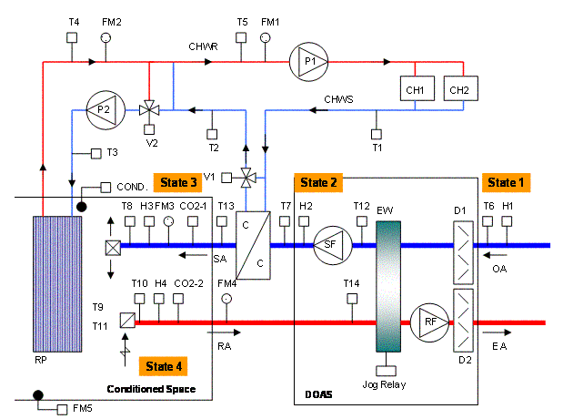
Tempering OA without the loss of air side economizer!
DOAS Unit
Parallel sen. unit

Slide 34
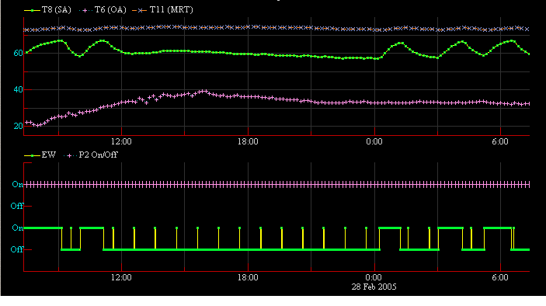
Free cooling performance data
Space T (MRT)
SA DBT
OA DBT
Panel Pump (P2) On
EW on/off
Midnight
Cleaning Cycle: “on” 2 min/hr

Slide 35
2. EW wheel frost control to minimize energy use.

Slide 36
EAH
RA
5
3
4
Space
OA
EAH
PH
CC
Process line cuts sat curve:
cond. & frost
OA
New process line tangent to sat. curve, with PH.
PH
New process line with EAH

Slide 37
Reduced wheel speed:
Another EW frost prevention control.
Very negative capacity consequences when heat recovery most needed (at -10F, wheel speed drops to 2 rpm to prevent frosting), capacity reduced by >40%.
Suggest avoiding this approach to frost control.

Slide 38
3. Control to minimize the use of terminal reheat.

Slide 39
Limit terminal reheat energy use
Reheat of minimum OA is permitted by Std. 90.1. Very common in VAV systems.
Two methods used w/ DOAS to limit terminal reheat for time varying occupancy:
  DOAS SA DBT elevated to ~70F. Generally wastes energy and increases first cost for the parallel terminal sensible cooling equip. (not recommended!)
  Best way to achieve limited terminal reheat is DCV. (saves H/C energy, fan energy, TER eff)
    CO₂ based
    Occupancy sensors

Slide 40
4. Pressurization control.

Slide 41
Building Pressurization Control
Pressurization vs. infiltration as a concept.
outside
envelope
inside
Pressure-positive
Pressure-neutral
Infiltration Air
flow direction

Slide 42
Building Pressurization Control
Pressurization vs. exfiltration as a concept.
outside
envelope
inside
Pressure-neutral
Pressure-positive
Exfiltration Air flow direction

Slide 43
Building Pressurization Control
Active Pressurization Control
outside
envelope
inside
Pressure:
P₂=P₁+0.03” WG
Controlled variable, ΔP
Pressure: P₁
Air flow direction, 1,000 cfm

Slide 44
Building Pressurization Control
Controlled flow pressuration.
What happens to depen-
dent variable P₂ if wind
vel. increase P₁, w/
controlled flow?
(pressurization flow no
more than 1,000 cfm)?
outside
envelope
inside
Pressure: P₁
Pressure: P₂ > P₁
Controlled variable:
flow, not ΔP
Air flow direction, 1,000 cfm

Slide 45
Building Pressurization Control
Active Pressurization Control
  Conclusion: It is highly recommended that building pressurization be flow based, not differential pressure based!

Slide 46
Unbalanced flow @ TER if pressurization is
½ ACH (~0.06 cfm/ft²) based upon Std. 62.1
i.e. means
RA = 70% SA:
Leads
to unbalanced flow at
DOAS unit

Slide 47
Impact of unbalanced flow on EW
h₄
RA, m_{RA}, h₃
OA, m_{OA}, h₁
h₂
ε =(h₄-h₃)/(h₁-h₃), for balanced or press’n unbalanced flow
ε_{app}=(h₁-h₂)/(h₁-h₃)=ε *m_{RA}/m_{OA} Note: ε =ε_{app} w/ bal. flow
ε_{app} (apparent effectiveness) accounts for unbalanced flow.
ε_{app} ≠ net effectiveness (net ε, AHRI 1060 rating parameter)
net ε accounts for leakage between the RA (exh.) and OA

Slide 48
100% 83% 67% 50% 33%
energy recovery, %
effectiveness, ε
app. effectiveness, ε_{app}
Hi
Low
Balanced flow
Unbalanced flow, 33% RA

Slide 50
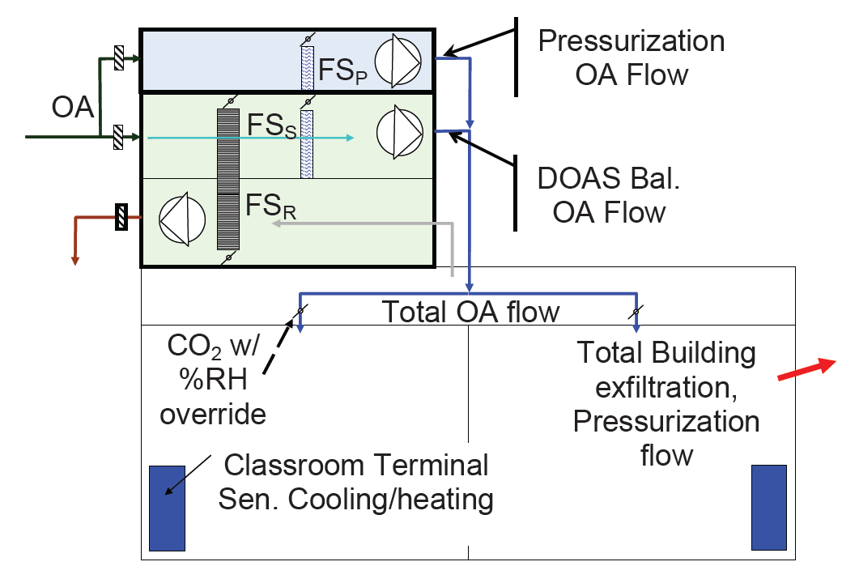

Slide 51
Sequence for the pressurization control.
Pressurization unit to operate during all occupied periods;
Pressurization unit to operate during unoccupied periods provided dehumidification is required as indicated by the OA DPT (in excess of 60°F (15.5°C)—adjustable setpoint)
Damper A to modulate open in sequence (to ensure the pressurization enclosure is not damaged by negative pressure) with the fan when the system is to operate.

Slide 52
Sequence for the pressurization control.
When the pressurization air fan is to operate, setpoint (adjustable but initially set to the floor component of Standard 62.1) shall be maintained with a VFD based upon the flow station (FSP). Setpoint adjustable to accom-modate seasonal changes, & unforeseen pressurization or reserve capacity needs;
When pressurization unit is to operate, the CC shall cool the air to setpoint (adjustable, but initially set at 48°F [9°C] DBT) provided the OA DPT >48°F (9°C);

Slide 53
Sequence for the pressurization control.
When pressurization unit is to operate and the OA DPT <48°F (9°C), the CC shall cool the air only as required to handle the space sensible load in cooperation with the DOAS; and
When pressurization unit is to operate and cooling is not required, fully open the CC bypass damper. Otherwise, the damper is to be fully closed.

Slide 54
Conclusions,
Fortunately, DOAS controls are simpler than VAV control systems.
Unfortunately, they require a different paradigm—something the industry is just coming up to speed on.
A properly designed and controlled DOAS will reduce:
  Energy use/demand,
  First cost,
  Humidity problems and related IEQ issues
  Ventilation compliance uncertainty.

Slide 55
Questions

